Slide 1
Simple Geometry and Disorder Effects on Electron Motion
Nicholas Webb, Devon Martin, Christina Chuong, Grant Broussard

Slide 2
Experiment:
Observe how increasing lattice disorder affects conductivity in solids
Christina

Slide 3
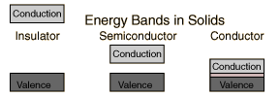
Theory:
Hückel method (applied to solids)
Solids have energy spectrums with continuous and discrete aspects
Predicts that the difference in energy between LUMO and HOMO varies according to length of a conjugated chain
Christina
Notes:
Our model will show as number of atoms goes to infinity, the spacing between energy levels becomes infinitesimally small, and the energy spectrum becomes continuous or have a better conductivity.

Slide 4
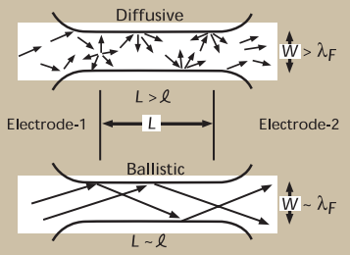
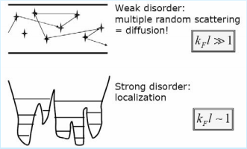
Theory:
Weak Localization
Electron motion in a disordered system is diffusive rather than ballistic
Resistivity is related to the probability of an electron to propagate between two points in space
Anderson/Strong Localization
There exists a critical disorder at which an electron at one energy does not diffuse (conductivity is zero)
As disorder increase, diffusion is slow, and a system can transitions from metal to nonmetal
Christina
Notes:
Diffusive rather than ballistic meaning instead of traveling in a straight line, experiences a series of random scatterings off impurities
Weak Localization > precursor to Anderson Localization
Mean free path, average length an electron travels before colliding with another atom, decreases with increase in disorder

Slide 5
Our Model:
Starting with a 1D Chain Model
Devon

Slide 6
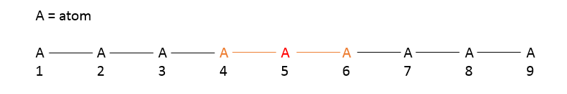
1-Dimensional Chain Model
Every atom has up to two nearest neighbors, as indicated by the red atom 5.
In the Hamiltonian matrix for atom 5,
H(5,5) = alpha
H(5,4) = beta
H(5,6) = beta
There are two geometric ways that disorder is introduced in a 1D system:
Manipulate the number of atoms in the chain
Manipulate the distance between atoms in the chain
Devon

Slide 7
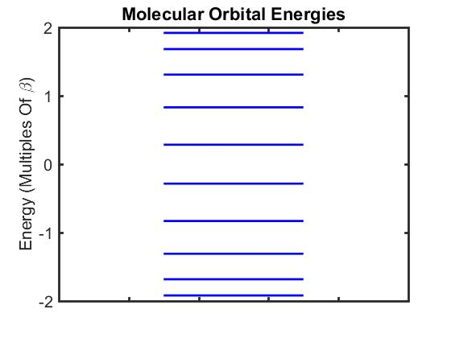
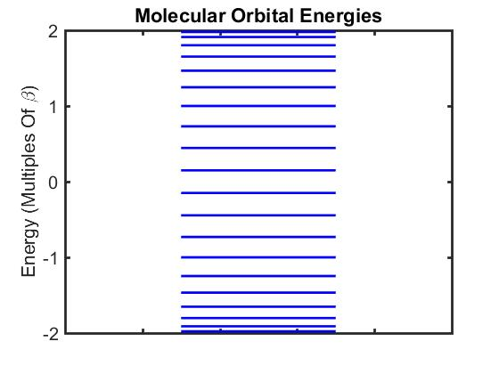
Effects of Chain Length in 1D Model
n=10 n=30
n=10
n=20
Grant

Slide 8
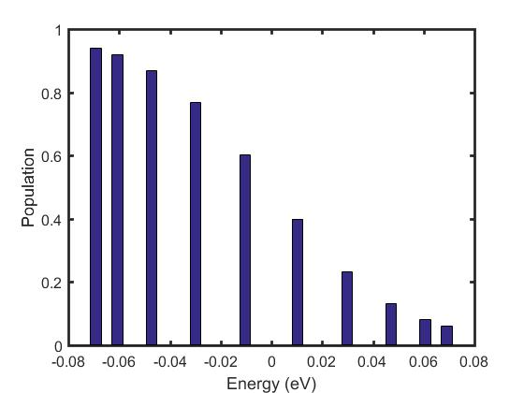
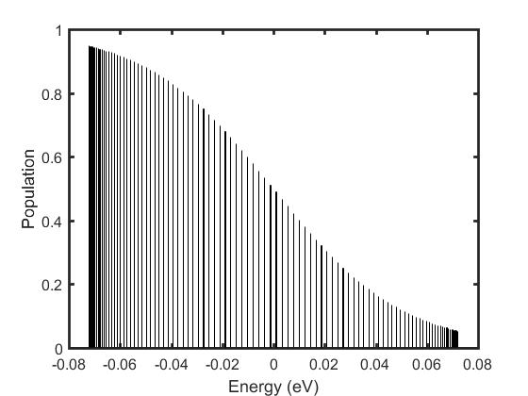
Effects of Chain Length in 1D Model
n=10
n=10 n=100
n=10
n=20
Grant

Slide 9
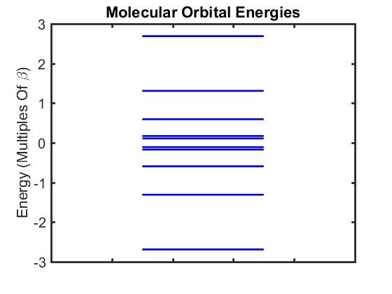
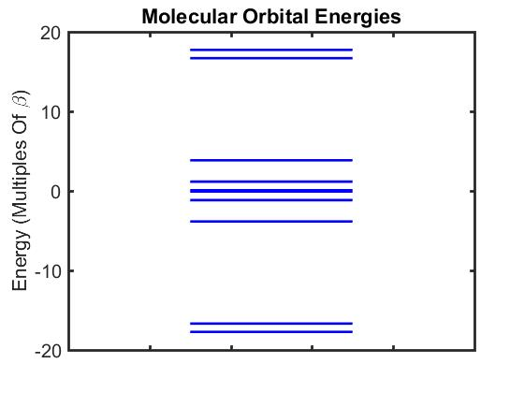
Effects of Disorder in 1D Model
df=0
df=1
df=10
Grant
n=10

Slide 10
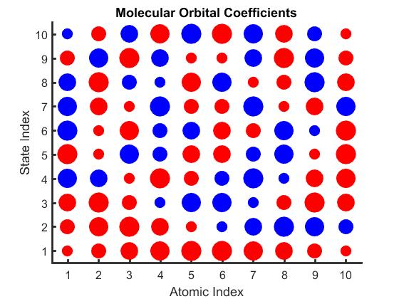
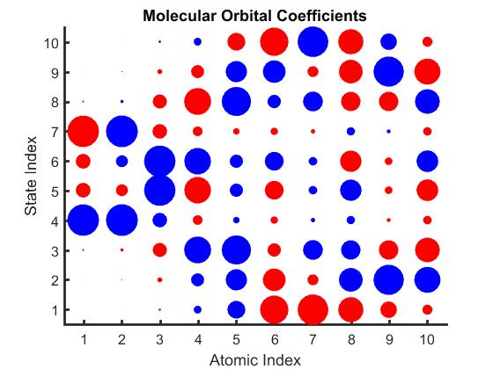
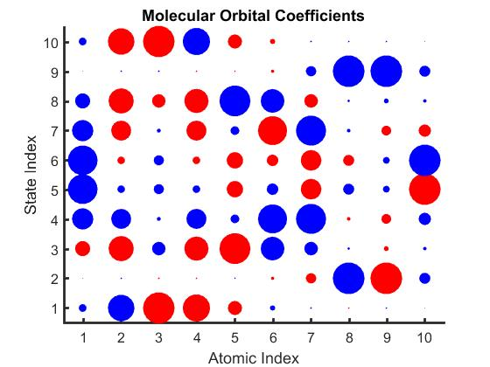
Effects of Disorder in 1D Model
df=0
df=1
df=10
Grant
n=10

Slide 11
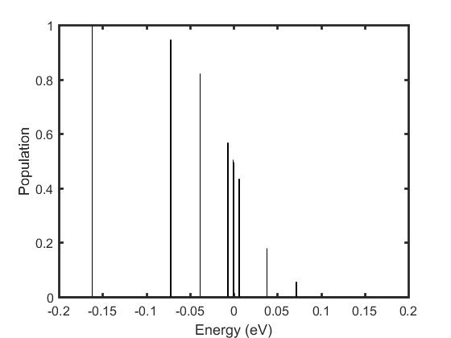
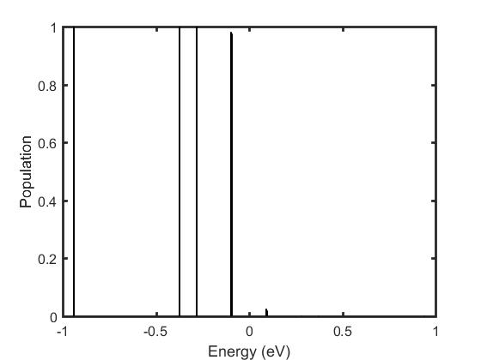
Effects of Disorder in 1D Model
df=0
df=1
df=10
Grant
n=10

Slide 12
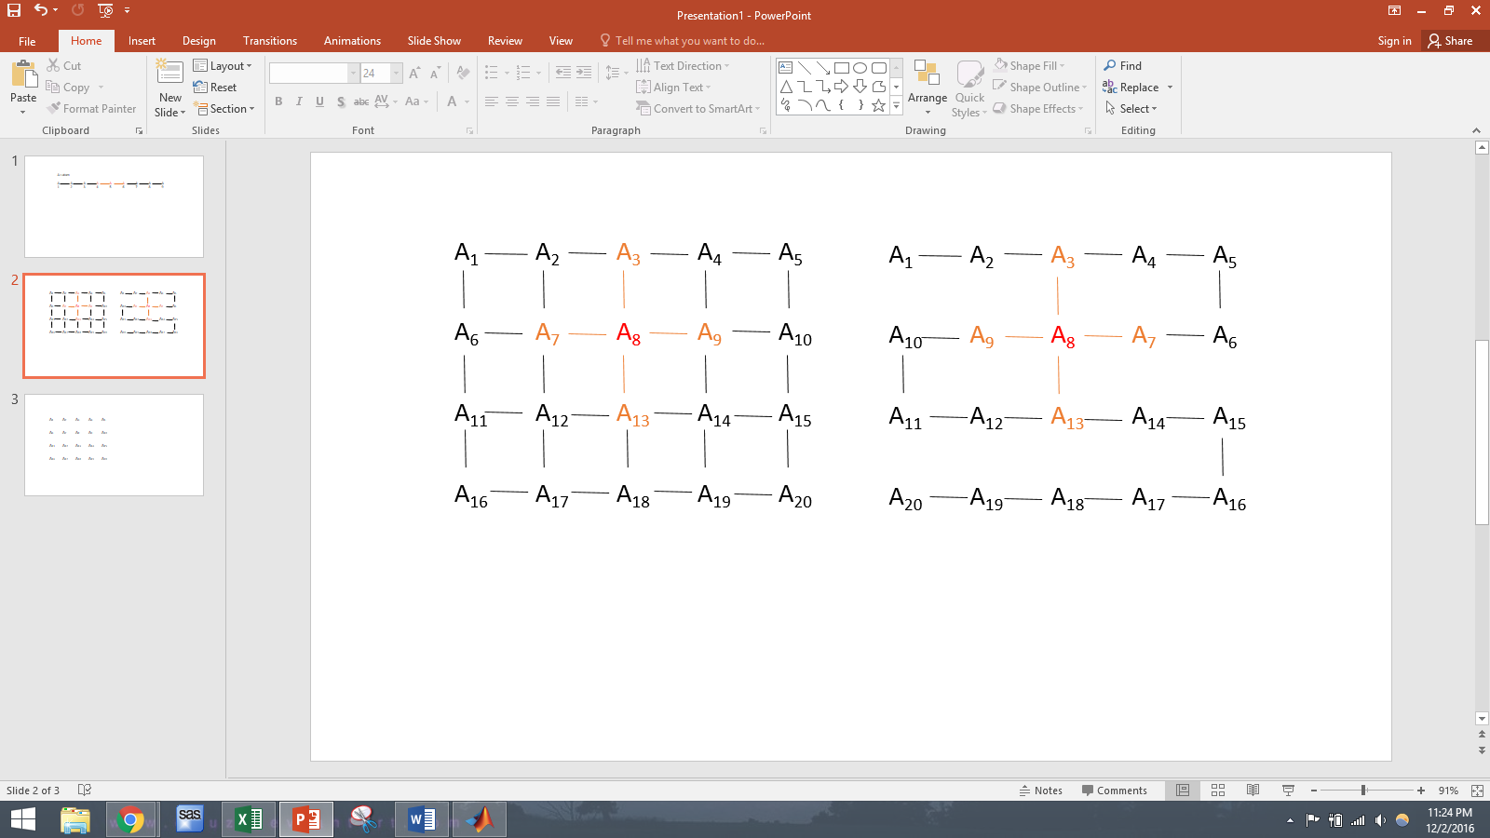
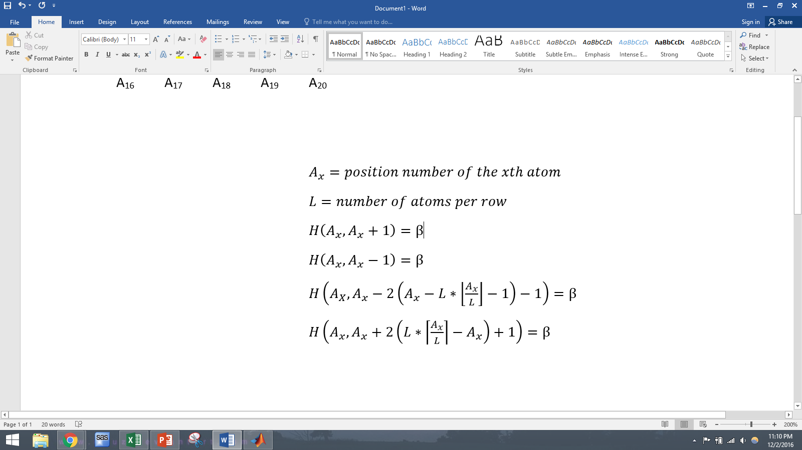
Create 2D Model from 1D Model
Every atom has up to four nearest neighbors, such as atom 8, which has its two neighbors from the 1D model, A7 and A9, as well as two new nearest neighbors, A3 and A13
Disorder is introduced by manipulating any of these bond lengths
Devon

Slide 13
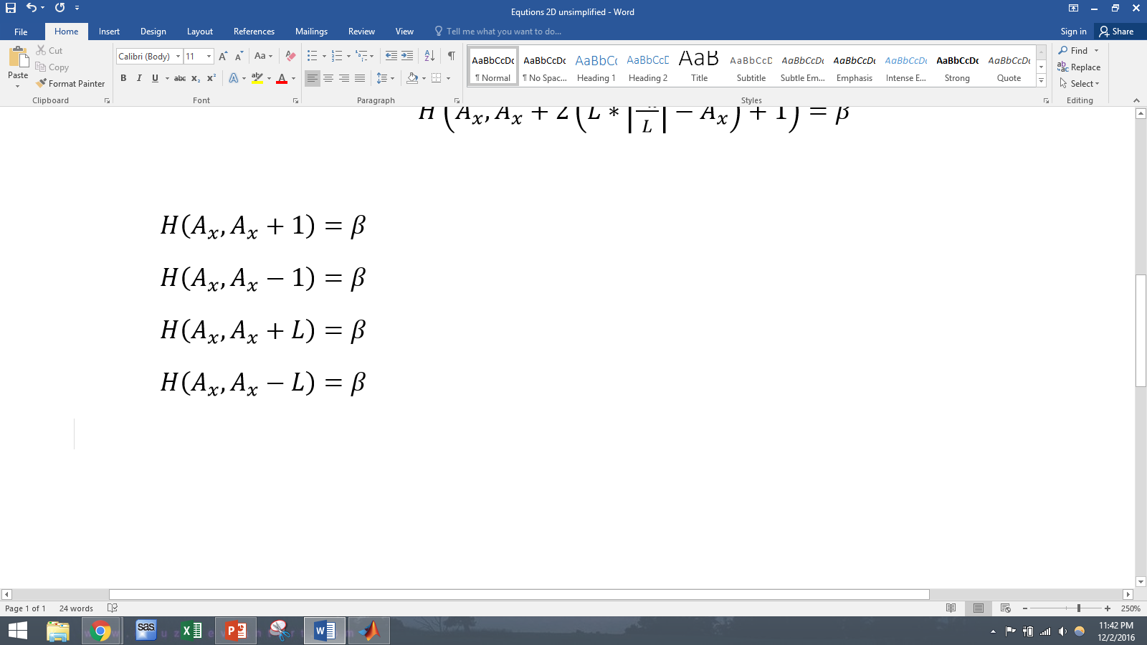
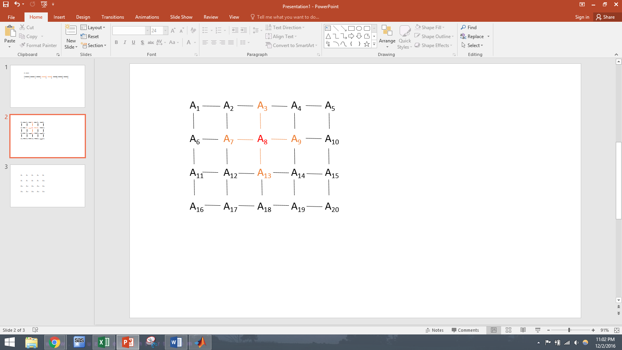
2D Model Simplification
By redefining the number system, the equations for 2D nearest neighbors become greatly simplified, so these formulas will be used following this model
Devon

Slide 14
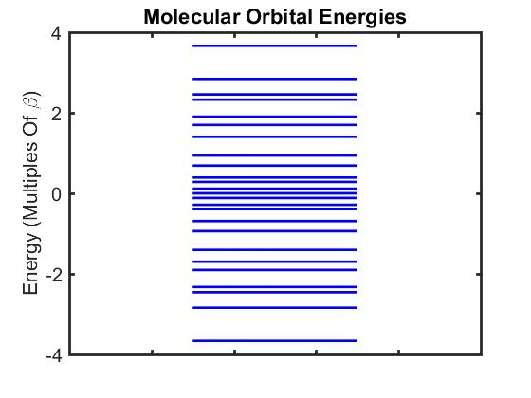
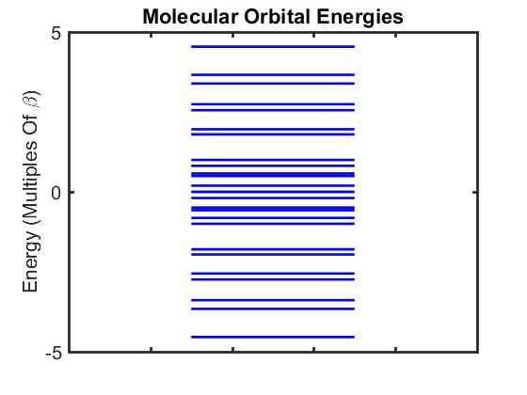
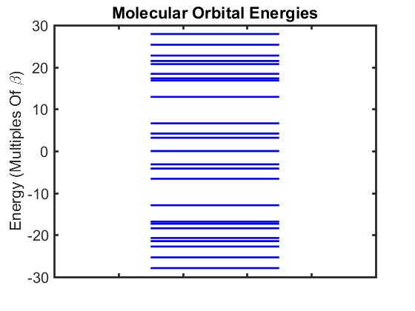
Effects of Disorder in 2D Model
df=0
df=1
df=10
Grant
n=25

Slide 15
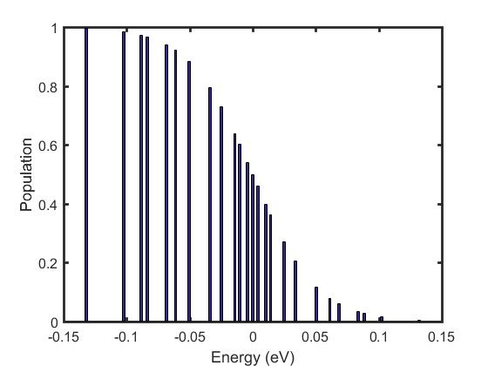
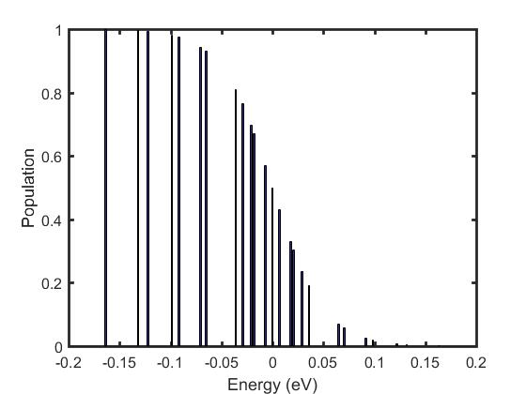
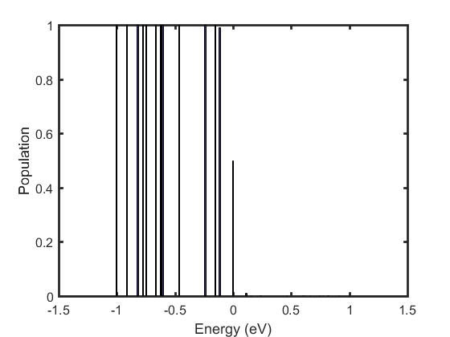
Effects of Disorder in 2D Model
df=0
df=1
df=10
Grant
n=25

Slide 16
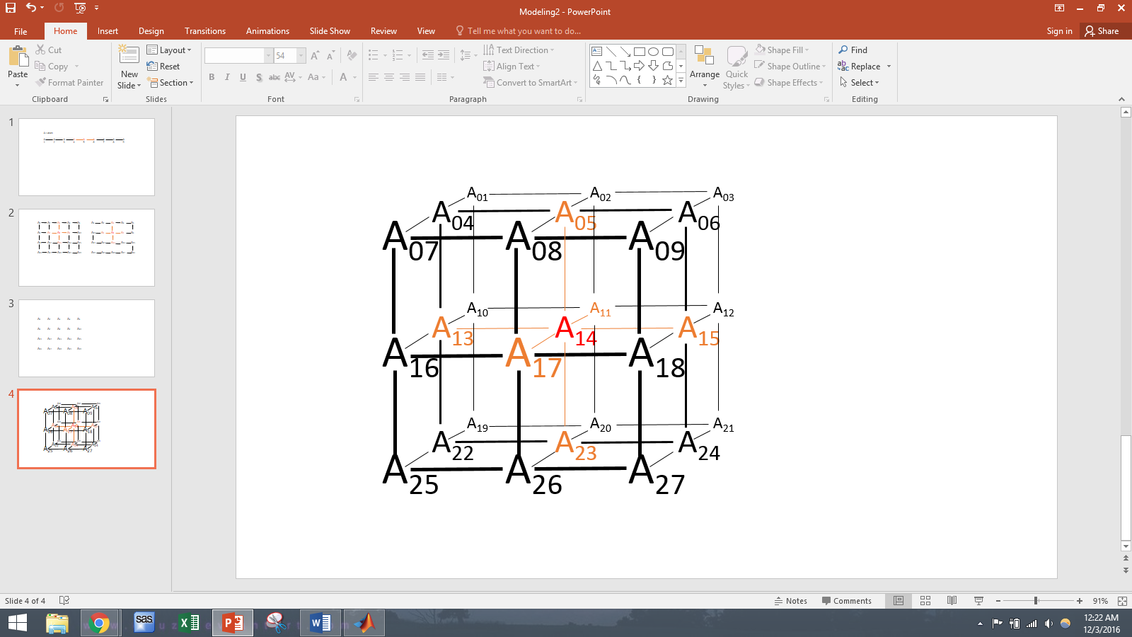
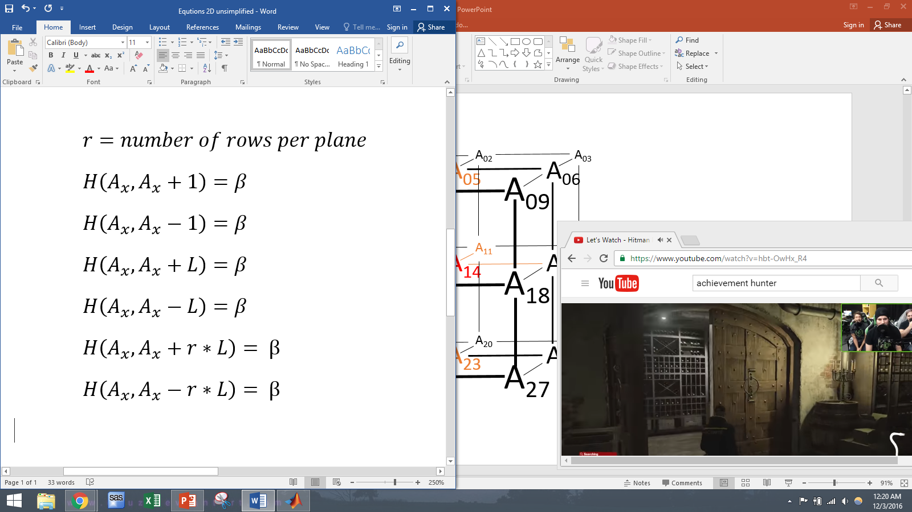
3D Model Creation
By setting planes from the 2D model on top of each other, a 3D structure can be created
Now every atom can have up to six nearest neighbors, 2 from the 1D model, 2 more from the 2D, and 2 new ones
Devon

Slide 17
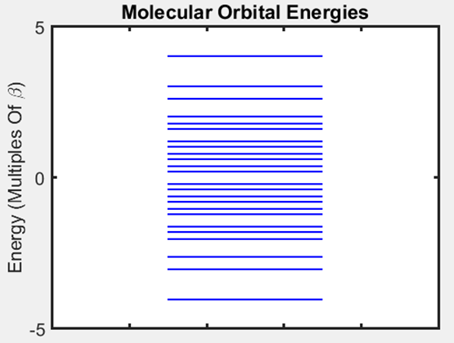
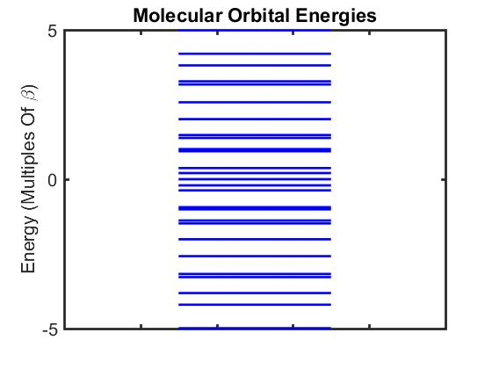
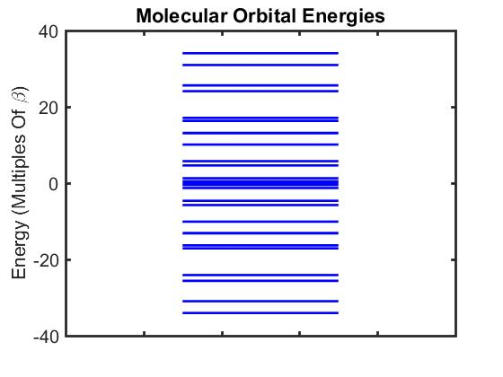
Effects of Disorder in 3D Model
df=0
df=1
df=10
Grant
n=27

Slide 18
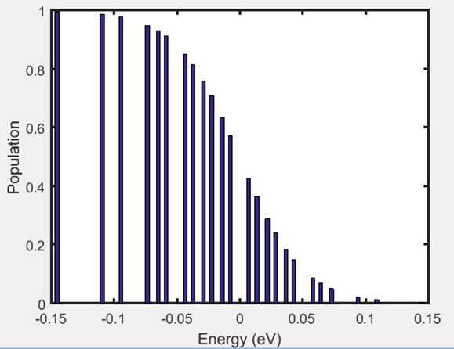
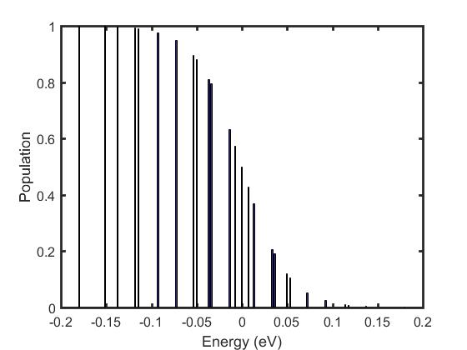
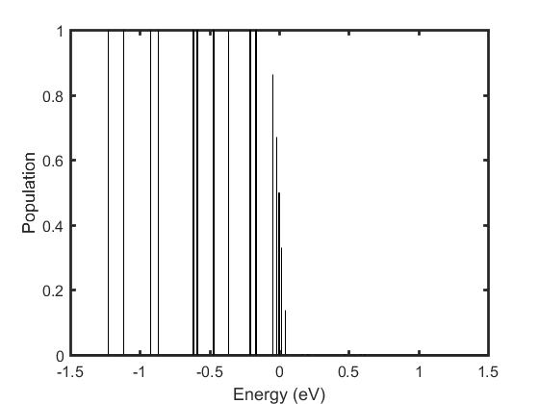
Effects of Disorder in 3D Model
df=0
df=1
df=10
Grant
n=27

Slide 19
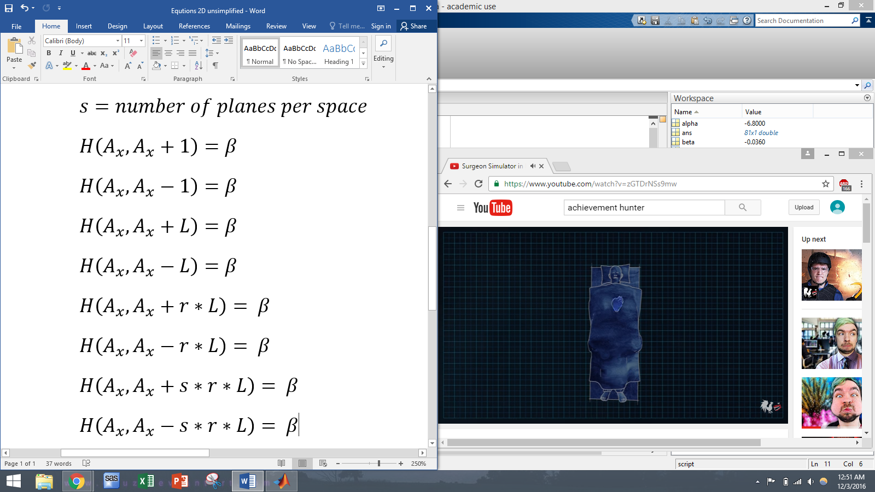
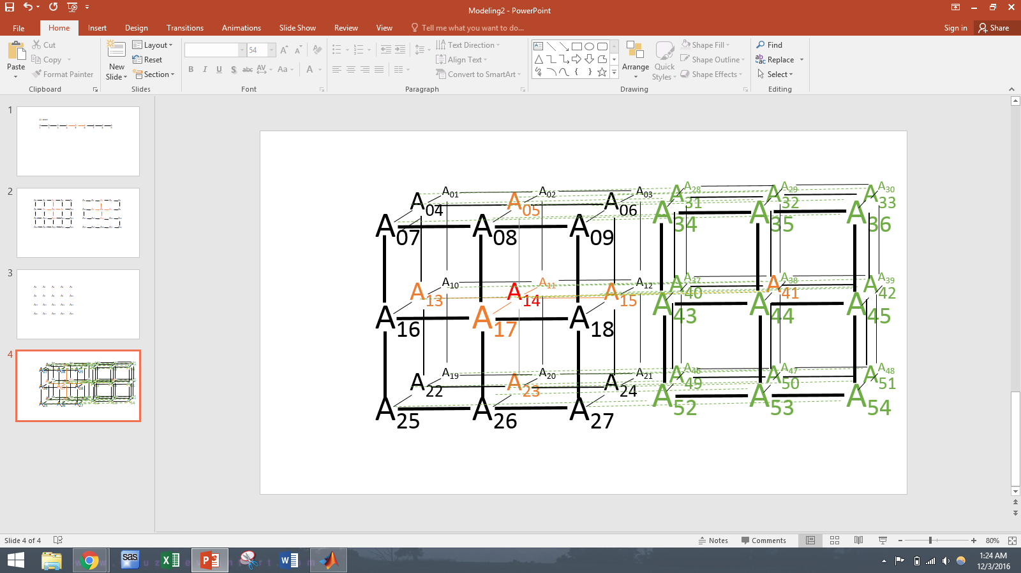
Theoretical Structures: 4D Model
By setting spaces from the 3D model on top of each other, a 4D structure can be created. Higher-dimensional models can be created similarly.
Now every atom can have up to eight nearest neighbors, 2 from the 1D model, 2 from the 2D, 2 from the 3D, and 2 new ones, A41 and A-13 (not shown)
Devon

Slide 20
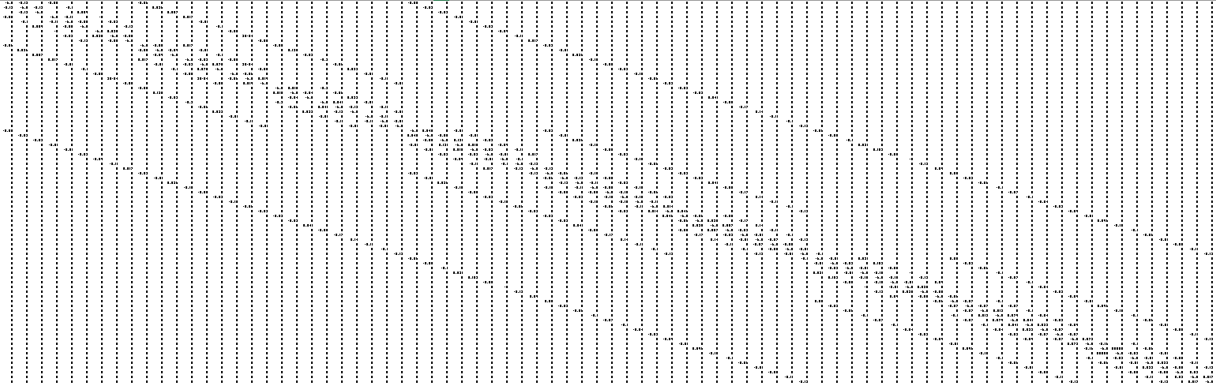
The Hamiltonian Matrix (4D)
An interesting pattern occurs in the Hamiltonian Matrix.
4D Model is 3x3x3x3
Hamiltonian Matrix is 81 x 81
Nick

Slide 21
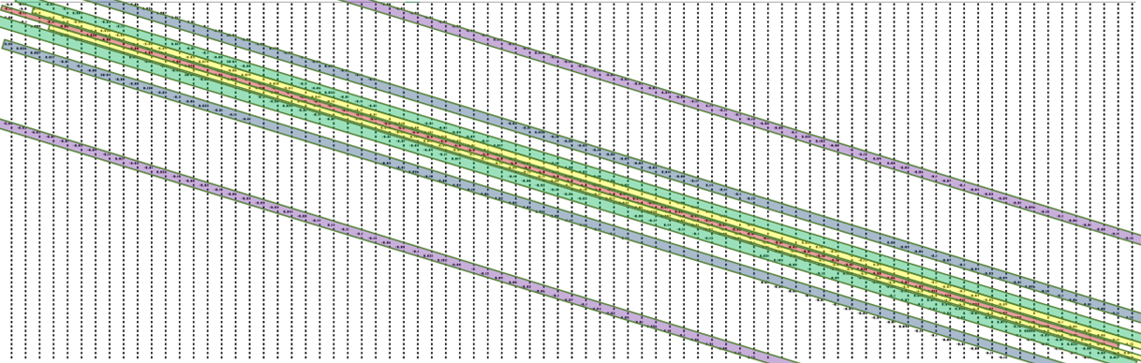
Interpretations (3x3x3x3)
0D (red), 1D (yellow), 2D (green), 3D (blue), 4D (purple) bands
The bands are separated by specific lengths depending on the scalar of the dimensions
Note the symmetry
Nick

Slide 22
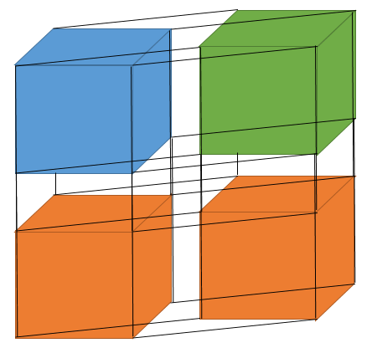
Prediction for Future Experiments based on Model
Blue is the original 3x3x3 structure
Green is the added 3x3x3 (3D structure) that forms the 4D structure when added to blue, forming a 3x3x3x2 structure
Orange is the added 3x3x3x2 (4D structure) that forms a possible 5D structure when added to the blue and green 4D structure, forming a 3x3x3x2x2
The Hamiltonian can be expected to have a 4D band at a position 18 (3x3x2) away from the diagonal and a 5D band 36 away (3x3x2x2)
There are 32 corners
Devon

Slide 23
Extreme Entropy:
Removal of Certain Atoms
Removal of central atoms from the lattice causes a hole, or impurity, which adds some distortion to the electron distribution in the lattice
Decreases the movement of electrons through a metal leading to lower conductivity
Nick

Slide 24
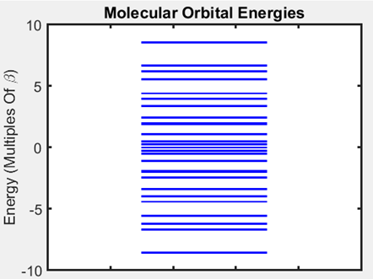
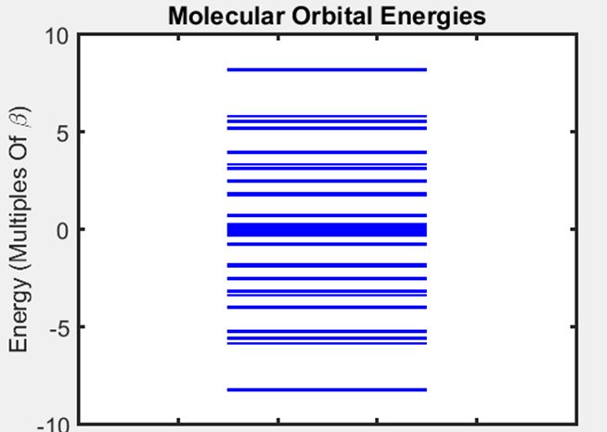
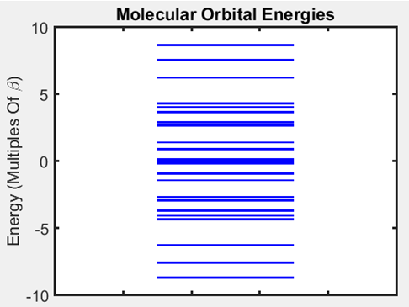
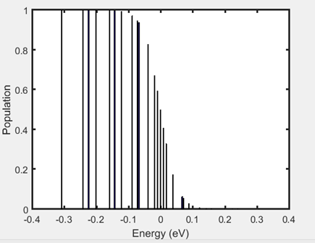
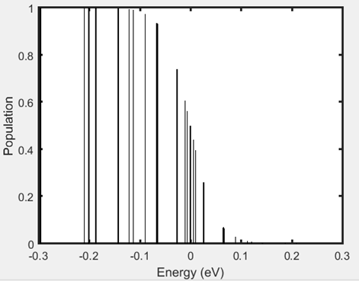
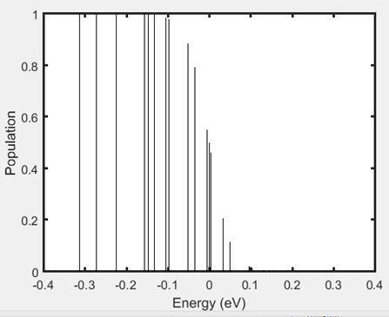
Normal Model (3x3x3)
Removed Center Atom
Removed Center Row
Nick

Slide 25
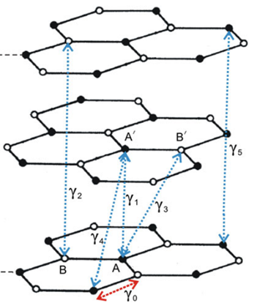
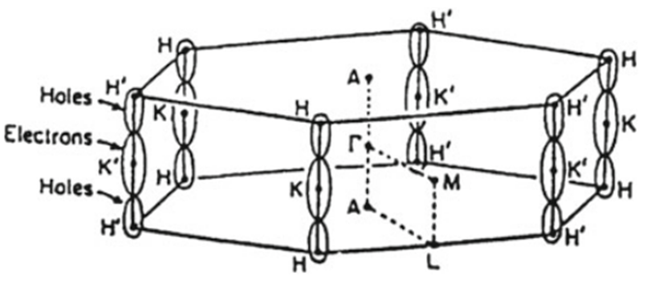
Anisotropy Theory
Anisotropy: having properties that differ depending on the direction of movement
A common example is in graphite, which has conductance between carbon planes caused by pi overlap, but doesn’t have conductance in the direction normal to this plane
We can represent basic anisotropy results with our model by removing beta values in only certain directions
Littlejohn, Samuel David; Electrical Properties of Graphite Nanoparticles in Silicone Flexible Oscillators and Electromechanical Sensing, Springer (2014)
Nick

Slide 26
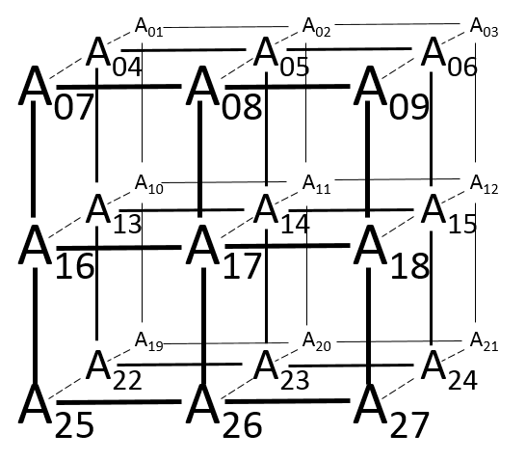
Modelling Anisotropy
We weakened the beta-values between planes so that moving in the direction A7 to A1 has significantly less conductance
Anisotropy is directional entropy
Nick

Slide 27
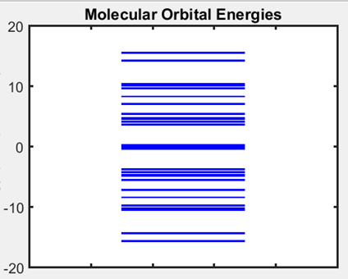
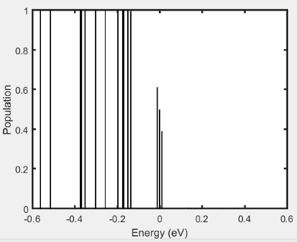
Anisotropy Results
Nick

Slide 28
Sources
Engel, T. Quantum Chemistry & Spectroscopy, 3rd ed.; Pearson Education: New York, 2010
Lagendijk et al. Fifty Years of Anderson Localization. Physics Today. 2009.
Rao, C.N.R. Trends in Chemistry of Materials; World Scientific Publishing Co.: Toh Tuck, 2008.
Littlejohn, Samuel David; Electrical Properties of Graphite Nanoparticles in Silicone Flexible Oscillators and Electromechanical Sensing, Springer (2014)

